Slide 1
DevOps on IBM i
Proof of Concept
Nourilee Santos, Application Developer – RPG
November 2016

Slide 2
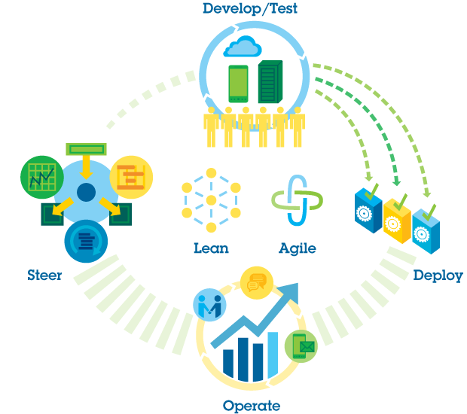
DevOps takes a closed-loop approach to application delivery
Extending Lean and Agile practices across the entire software value chain.
What is
DevOps
Notes:
DevOps is an approach that promotes closer collaboration between lines of business, development and IT operations. Development, testing, operations and lines of business were often isolated from each other in the past. DevOps brings them together to improve agility.

Slide 3
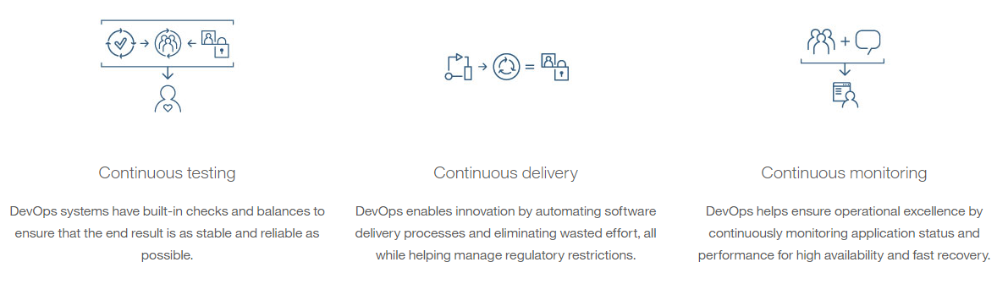
Why DevOps?
Notes:
DevOps is an enterprise capability that enables the continuous delivery, continuous deployment and continuous monitoring of applications.

Slide 4

Push Button Test, Build and Deployments
Deliver
Request
Build
Built
Artifacts
Develop
SCM
Build
Deploy
IDE
CI Tool
AS400 Platform
System of Record
Notes:
Technology can help us do this. By implementing tooling that automates deployment along with tooling that helps us more to easily test what is ready and virtualize the rest.

Slide 5
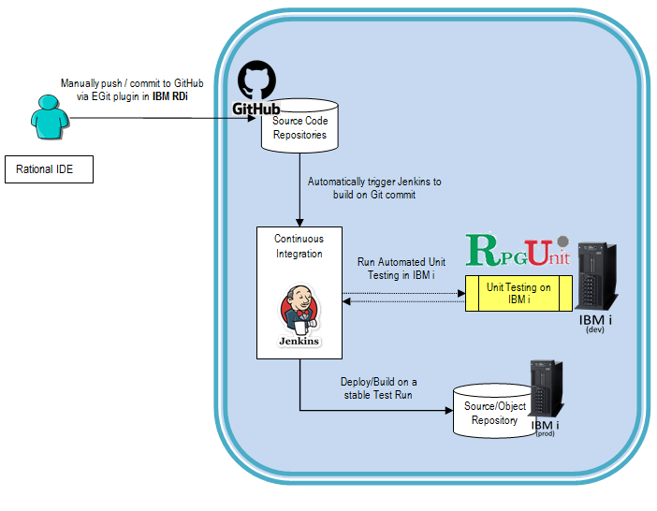
POC Architecture
Notes:
This is simply an example of a DevOps delivery pipeline showing a set of capabilities and the tools supporting them as an integrated system. There are other tools that can/should be added based on the workload. The pipeline is built on an open standards based platform and a set of services enabling software teams to leverage open source and third party tools.
During our POC, we are limited to free and open source tools because of budget constraints. The developers also have access limitations, thus we try to avoid tools that require system setups and modifications.

Slide 6
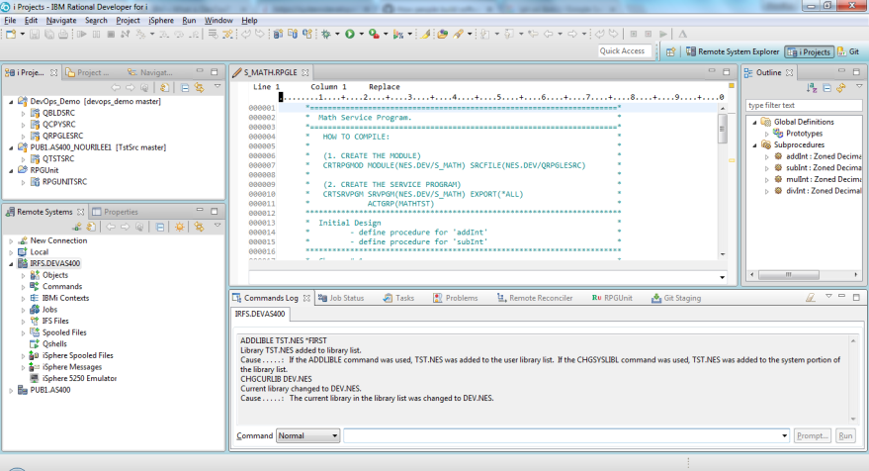
Tools and Frameworks
IBM® Rational® Developer for I
  integrated development environment (IDE) built on the Eclipse platform.
  designed for creating and maintaining applications on IBM i systems
  it resides on the developer’s desktop, supporting development in both host-connected and disconnected modes.
  faster and more modern

Slide 7
Tools and Frameworks
Git is an open source distributed Source Control Management (SCM) system, also called a Version Control System (VCS). Git is the most popular SCM for Open Source Software (OSS) and allows easy sharing of code using sites like GitHub, Gitlab, and Bitbucket - though a cloud provider is not required for code hosting.
  GitHub is a web-based Git repository hosting service. It offers all of the distributed version control and source code management (SCM) functionality of Git as well as adding its own features.
  Git on IBM i, IBM i 7.3, runs in the PASE environment, essentially a full AIX runtime using IBM i as its kernel. This means we can run many AIX tools and applications unchanged on IBM i. Now with Git on IBM i, you can create your own ‘on prem’ source control library that leverages the latest open source support. Not only can you use it for all your open source projects, with modern RPG where the source is located in the IFS, you can also leverage GIT to control your RPG projects! There is even a GIT plugin that fits in nicely to your RDi development environment.

Slide 8
Jenkins
Jenkins is an open source automation server written in Java.
Jenkins is an award-winning, cross-platform, continuous integration and continuous delivery application that increases your productivity.
Use Jenkins to build and test your software projects continuously making it easier for developers to integrate changes to the project, and making it easier for users to obtain a fresh build. It also allows you to continuously deliver your software by providing powerful ways to define your build pipelines and integrating with a large number of testing and deployment technologies.

Slide 9
RPGUnit
RPGUnit is an open source framework aimed at making unit testing easy for RPG programmers.
RPGUnit is a regression testing framework, similar to JUnit but written in RPG, a procedural language mainly found on the iSeries platform (a.k.a. AS/400). Developers use it to implement unit tests in RPG ILE. RPGUnit is Open Source Software, released under the Common Public License Version 1.0 and hosted on SourceForge .
Notes:
In this POC, we apply a Test-Driven development. Test-driven development (TDD) is a development technique where you must first write a test that fails before you write new functional code.
There’s a handful of TDD tools available but there are only few options for the IBM i developers:
jUnit (but it will be overwhelming for RPG developers to learn and code in Java)
Custom Built (but it will be time consuming to start from scratch)
RPGUnit

Slide 10
Demo
Proof of concept

Slide 11
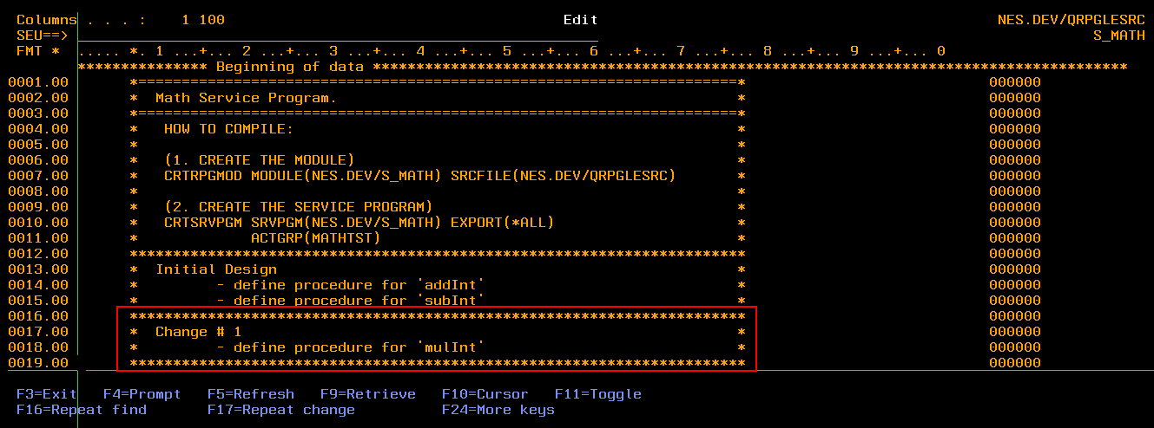
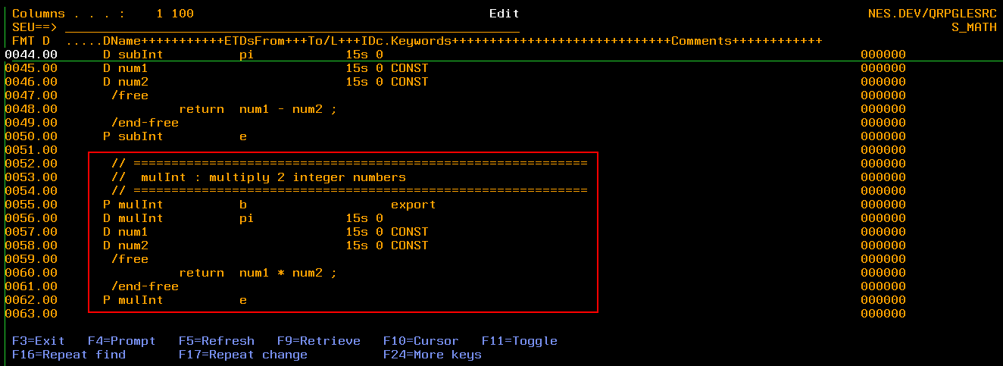
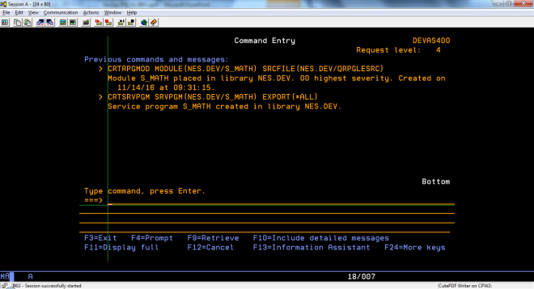
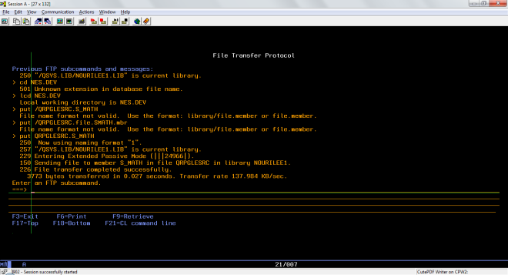
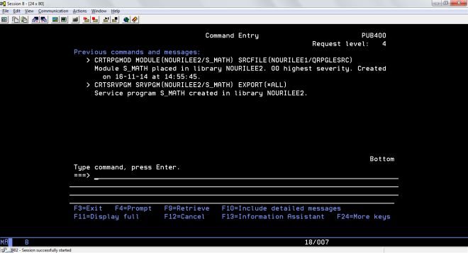
Before DevOps
Coding using SEU
Compile/Build Manually
Execute Unit Test Manually until all Test Cases PASSED
Deploy & Build
Manually

Slide 12
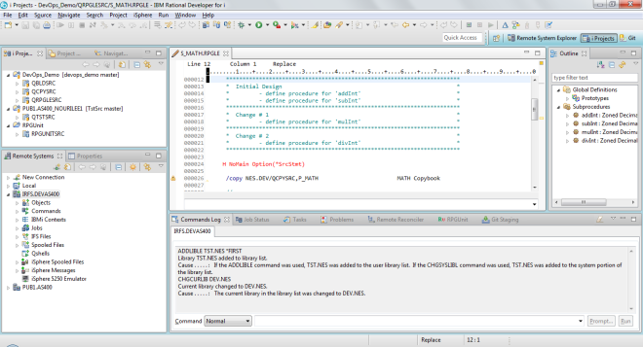
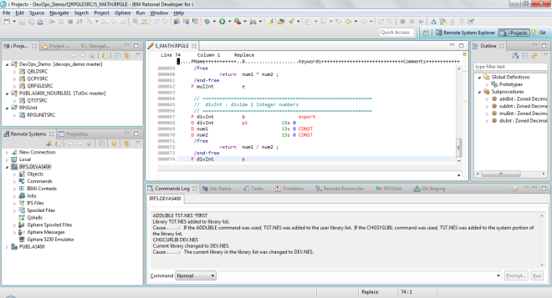
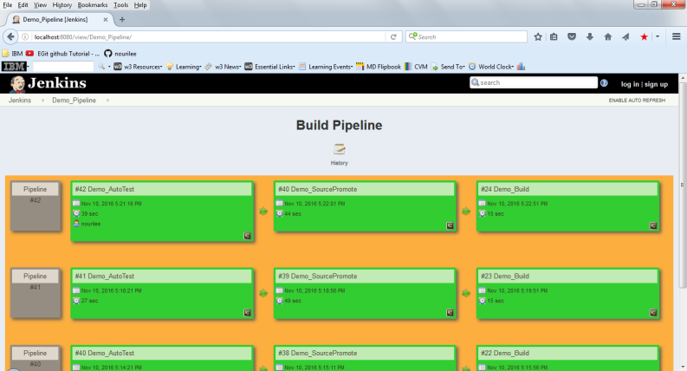
After DevOps
Coding using RDi
Push/Commit
Automated
Test
Deploy
Build

Slide 13
Next steps
Where can I learn more?

Slide 14
Resources
Continuing your ‘Understanding DevOps’ journey
For Dummies books:
  https://ibm.biz/mmdevops
  http://ibm.co/devopsfordummies
  http://ibm.co/agilefordummies
  http://ibm.co/ServiceVirtualizationForDummies
  http://ibm.co/ARDfordummies
IBM DevOps Page:
http://ibm.com/DevOps
IBM DevOps for Enterprise Systems:
http://bit.ly/1PB02KS
DevOps Lean Assessment (Beta):
http://bit.ly/IBMLeanAssess
Other tools
  http://github.com
  http://jenkins-ci.org
  http://rpgunit.sourceforge.net/

Slide 15
Thank You
© Copyright IBM Corporation 2015. All rights reserved. The information contained in these materials is provided for informational purposes only, and is provided AS IS without warranty of any kind, express or implied. IBM shall not be responsible for any damages arising out of the use of, or otherwise related to, these materials. Nothing contained in these materials is intended to, nor shall have the effect of, creating any warranties or representations from IBM or its suppliers or licensors, or altering the terms and conditions of the applicable license agreement governing the use of IBM software. References in these materials to IBM products, programs, or services do not imply that they will be available in all countries in which IBM operates. Product release dates and/or capabilities referenced in these materials may change at any time at IBM’s sole discretion based on market opportunities or other factors, and are not intended to be a commitment to future product or feature availability in any way. IBM, the IBM logo, Rational, the Rational logo, Telelogic, the Telelogic logo, and other IBM products and services are trademarks of the International Business Machines Corporation, in the United States, other countries or both. Other company, product, or service names may be trademarks or service marks of others.
Notes:
Thank You!

